Slide 1


Much Projects Holdings Pty Ltd
17 Van Lill Street, Witpoortjie, Roodepoort
www.muchprojects.co.za
E-mail: admin@muchprojects.co.za
Tel: 086 057 9290
Cell: 0832976995

Slide 2

Much Projects Holdings is a diversified business specialising in Plant Manufacturing and Maintenance, Meat Production, Property Rentals as well as CCTV Installation and Maintenance.
We are a customer focused business that is driven by a desire to add value and to contribute to the success and sustainability of those we serve. Our talented team, business processes and systems have been geared to ensure we deliver a superior service for our customers.
We continue to build the business on a foundation of sterling and hands-on leadership, exceptional business management practices, lean and efficient processes with the aim of delivering quality, personalised services at a reasonable cost to our customers.
We aggressively use technology to improve efficiencies and lower operational costs across all business divisions. We actively engage with our customers to ensure our services and solutions continue to add value to their triple bottom line. The company is managed by an experienced and capable team of executives who are committed to building strong relationships with all our customers, both large and small whilst steadily growing the business into a recognised and trusted South African brand.
Company Overview

Slide 3
Mission and Vision
To add value and to contribute to the success and sustainability of those we serve through our people. Our talented team, business processes and systems have been geared to ensure we deliver a superior service for our customers.
Values
Quality products
Excellent Customer Service
Accountability
Continuous learning and improvement
Teamwork
Honesty and Transparency
Acting with integrity

Slide 4

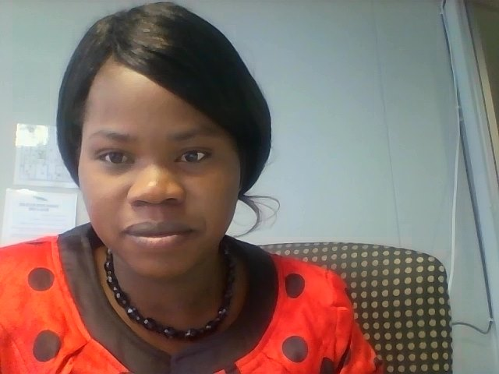
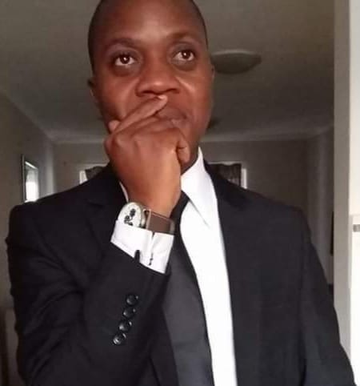
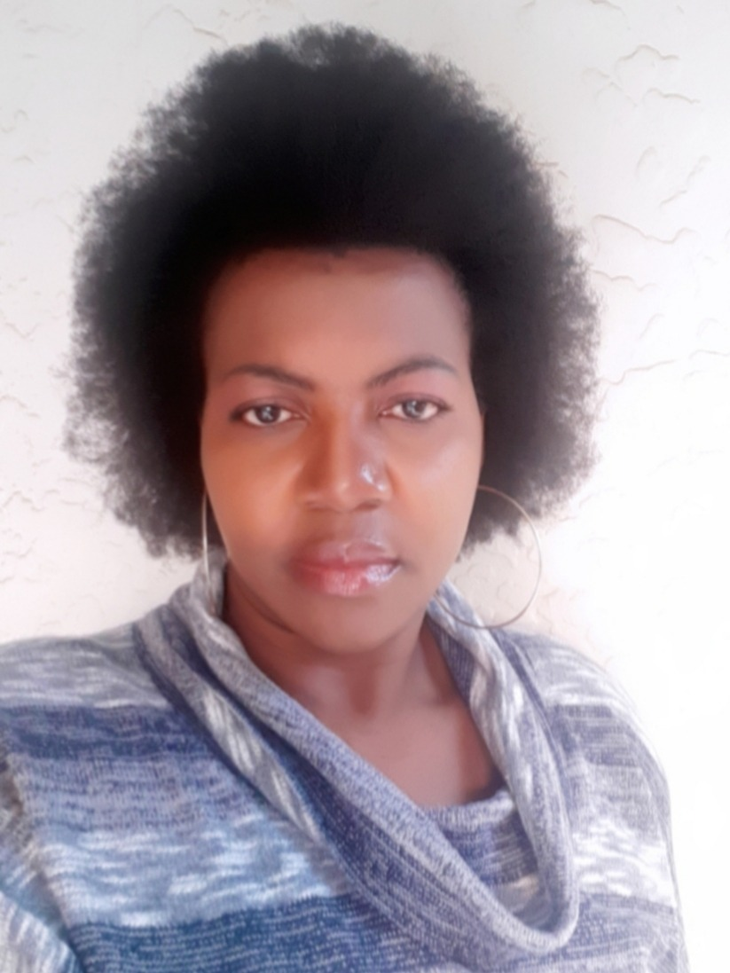
Meet the Management
Team
Jack
CEO
Courage
Manager: Property Rentals and CCTV Installation/repairs
Lesley
Manager: Engineering Projects and Maintenance
Naume
Manager: Meat Production

Slide 5
Divisions
Property Rentals and Management
CCTV Installation and Repairs-Home and business security solutions
Engineering Projects and Consulting
Meat Production- that includes Meat Processing, Egg Production, Broiler Production and Piggery

Slide 6
Our Services –Property Rentals and Management
We specialise in the following:
Student Accommodation servicing University of Johannesburg and University of Witwatersrand in Johannesburg
Residential property rentals in Johannesburg
Property Management on behalf of landlords
We ensures prompt and professional services in offering a suitable property to meet the tenant's rental needs as close as possible
We believe that meeting the tenant's needs are important to meet our key business objectives which include ensuring a properly maintained property throughout the lease.
Our offerings include student accommodation and private residential properties

Slide 7
Our Services –Engineering Projects and Consulting-SBW Holdings
We specialise in the following:
Structural, thermal & hygiene buildings
Plant Design and systems
Plate work
Fire protection
Supplying Mechanical engineering products and components
Chiller, freezer & controlled atmosphere solutions
Supply mechanical components and spares
Service, refurbish and install mechanical and electrical pumps (including alignment)
Service and refurbish all sizes and types of valves
All tubes and piping materials (steel i.e mild steel, carbon steel, stainless steel, cast iron)
Fabrication and specialized welding of pipes and components
Quality inspections of both mechanical and welding inspections according to ISO standards
Statutory pressure tests of pressure vessels and pipes according their codes of constructions
Gearbox service and installation (including alignment)
Corrosion protection (painting according to ISO standards)
Whether your businesses focus is large scale industrial systems or smaller mobile equipment, Much Projects’ subsidiary SBW Holdings team is ideally positioned to help you optimise plant and machinery performance, ensure up time and reduce day-to-day running expenses. Service and maintenance are tailored to meet our clients’ needs whether its design and manufacturing of the plant or the maintenance of the plant. Our team of experts (plumbers, electricians, boiler makers, pipe fitters, welders, engineers, boulders, diesel mechanics) will ensure that we render professional service.

Slide 8
Our Services –Security Services Solutions
We specialise in the following:
Home and Business Security Solutions
CCTV Installation & Repairs
Home and business security camera solutions
New CCTV Camera Installations & Repairs
Perimeter & Entrance Security Cameras
Indoor & Outdoor CCTV Camera Systems
Remote Viewing Off Cell Phone
We specialise in CCTV installations of top brands such as Hikvision, Mobotix, Geovision and Dahua CCTV camera systems. We can help with 8, 16 and 32 channel analog, IP network or hybrid CCTV Camera Systems incorporates Real-time day and night recordings. We also design a Custom CCTV or Wireless Networking Solution for your home and business. Our installations carries one-year warranty for equipment.

Slide 9
Our Services –Meat Production
We specialise in the following:
Poultry meat
Chicken Eggs
Piggery
Meat processing and packaging
Poultry feed production
Beef Meat
Fruit and Vegetables
Much Projects meat production division produces poultry, beef and pock products; both processed and raw products. We also produce other subsidiary products which include; incubation/hatchery, feeds production, fertilizers for farmers, fruit and vegetables for sale etc

Slide 10








Some of our Clients

